Slide 1
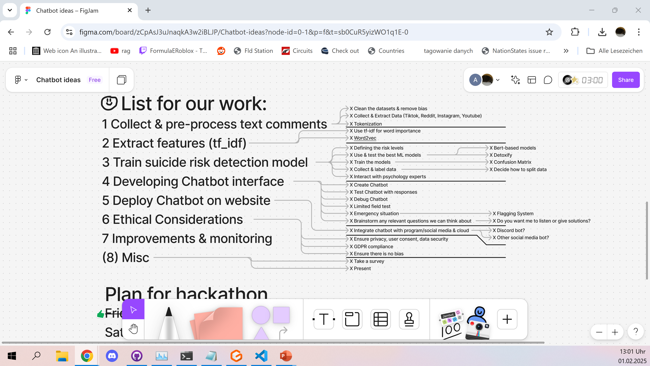
Hello!
I‘m [name], nice to meet you!
Previous Convo 1
Previous Convo 2
I can help you with:
-School
-Problems
-Anything!
Type something to get started!

Slide 2
This model can make mistakes. Make sure everything is true before believing it.
Hello!
Previous Convo 1
Previous Convo 2
I‘m Vera, here to help!
Type something to begin talking!
+

Slide 3
Current convo
Previous Convo 1
Previous Convo 2
Chat with Vera
+

Slide 6
Design philosophy:
Rounded edges, not sharp (comes over more casually)
Colours (helps with it not looking formal)
Not too many colours (as that looks childish)
Warm/happy colours (no blue pls that‘s sad)
Based off of other models (ChatGPT) so it‘s easy to use
No picture adding as that could be privacy concern
Use words like „Talk“ to descibe sending messages to the bot, as that makes it seem like you‘re talking with a bot and not just messaging a machine

